Slide 1
Coding with Java: Dropwizard
Women who code sg

Slide 2
Before we begin
IDEA
JAVA 8
MAVEN
CHROME
POSTMAN UI
GITHUB

Slide 3
What to expect
What is Dropwizard?
Hands-on Part 1: Hello You Explained
When to use Dropwizard?
Hands-on Part 2: RESTful services
Why Dropwizard?
Hands-on Part 3: Data and Persistence
Deep dives: Metrics, Security, Documentation

Slide 4
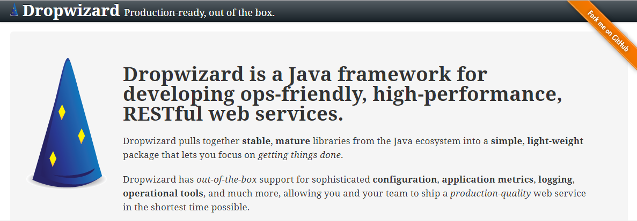
What is Dropwizard?

Slide 5
Once upon a time
TOMCAT
DROPWIZARD
FULL STACK FRAMEWORK
JPA
Jackson
SPRING
Logback
HIBERNATE
Spring MVC

Slide 6
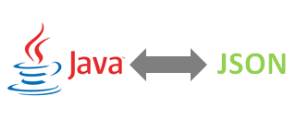
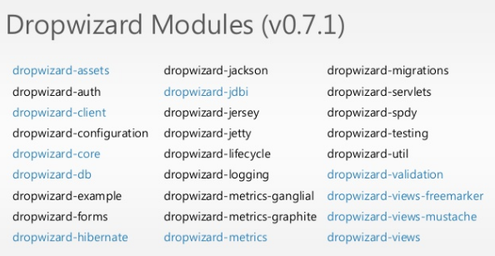


Best-of-breed Java Libraries
JETTY for HTTP
JERSEY for REST
JACKSON for JSON
METRICS for METRICS

Slide 7
Building Blocks of Dropwizard
YAML file/Configuration
Environment
Application
Resource
Representation
Bundle
Views

Slide 8
Hands-on Part 1: Hello You Explained
Tasks:
Create a new maven project
Add dropwizard core dependency
Create Configuration Class
Create Application Class
Run -> Main.java
Alternatively,
Clone project: https://github.com/wandatinkers/demo-dw-part1
Import project to IDE
Run -> Main.java

Slide 9
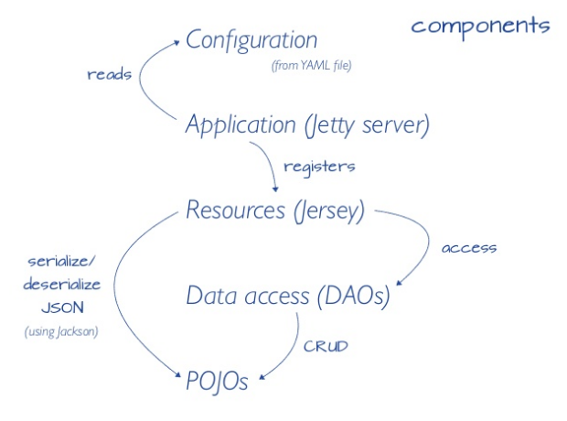
Components
How it works

Slide 10
When to use Dropwizard?
Simple to build
Rapid development
Simple to deploy
Single executable “fat” JAR files
Container-less
Simple to monitor
Admin Page
Metrics

Slide 11
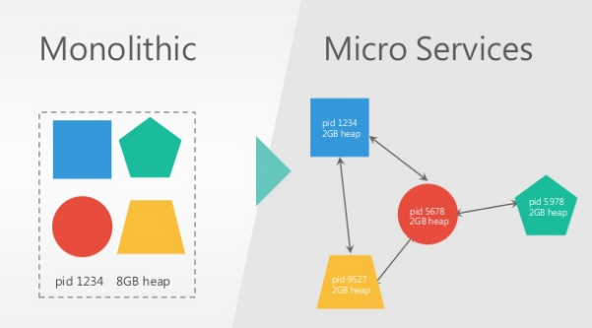
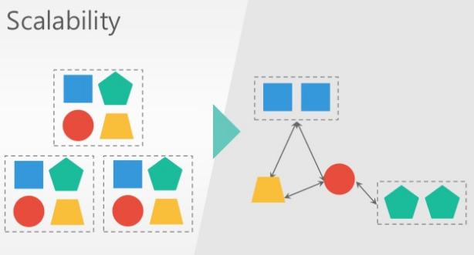
Microservices
Suite of small services
Communicate over lightweight mechanisms
Deployable by fully automated builds

Slide 12
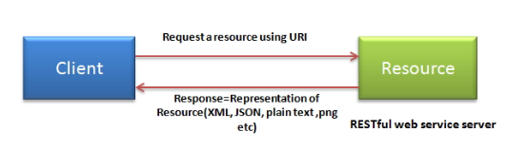
RESTful Services
R.E.S.T.
REpresentational State Transfer
Stateless architecture style based on web standards
Data and functionality are “resources”
Features of RESTful web services:
Resource identification thru URI
Uniform interface (CRUD)
Client-server
Stateless

Slide 13
OPERATIONS | OLD approach | RESTful approach
Create new item | createItem | /item
Update new item | updateItem?id=123 | /item/{id}
Get item | getItem?id=123 | /item/{id}
Delete Item | deleteItem?id=123 | /item/{id}

Slide 14
Hands-on Part 2: Rest Endpoints
Task: Create a rest service that will retrieve workshop information
Create a Representation Object
Create and register a Resource
Access new endpoint

Slide 15
Why Dropwizard?

Slide 16
Hands-on Part 3: Data Access
Tasks: Transfer the static workshop data in Part 2 to database
Register a Database Bundle
Create a new resource that reads from database
Access new endpoint
Alternatively,
Clone project: https://github.com/wandatinkers/demo-dw-part3

Slide 17
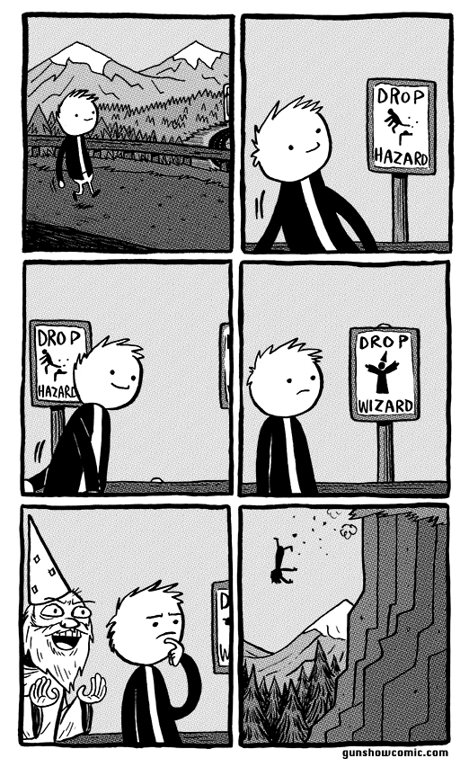
Takeaway Points

Slide 18
References

